Slide 1

Analysis of Unicorn Companies
Median Valuation of Unicorn companies:
2 Billion Dollars
Average number of years to become a unicorn company:
7 Years
Our Recommendations:
Companies aspiring to become unicorns should establish their presence in countries like USA and china as these countries probably have better conditions that have allowed greater number of unicorn companies to emerge compared to other countries.
Companies aspiring to become unicorn should try to get funding from the likes of Sequoia Capital, Speedinvest, Valar Ventures, Uniqa Ventures as they are the leading investors by their unicorn company portfolio.
investing in fintech and software services sector is very likely to yield greater return on investments as there are much more unicorn companies in these sectors compared to other sectors.
There doesnt seem to be any tangible relationship between the age of a company and its valuation. However, the average number of years it takes a company to become a unicorn company is 7 years. Companies aspiring to become unicorn should be able to demonstrate good leadership that will ensure the companies longevity beyond that average.

Slide 2
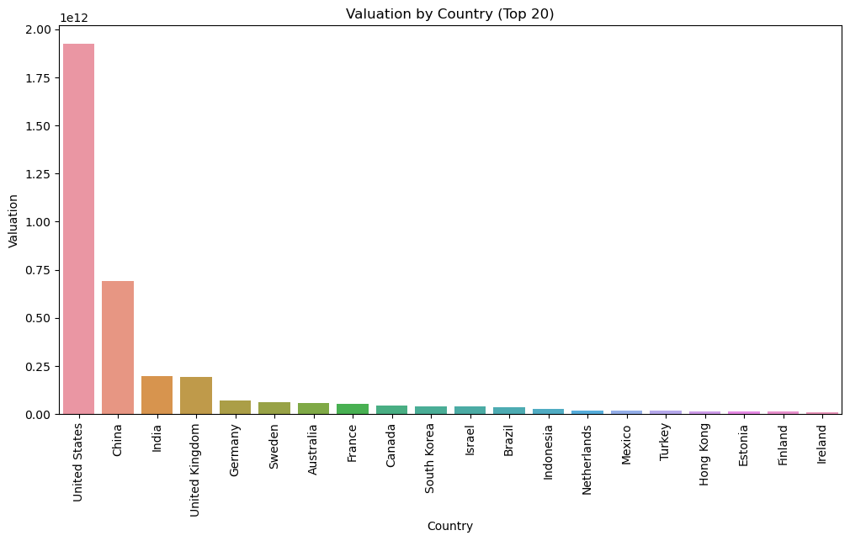
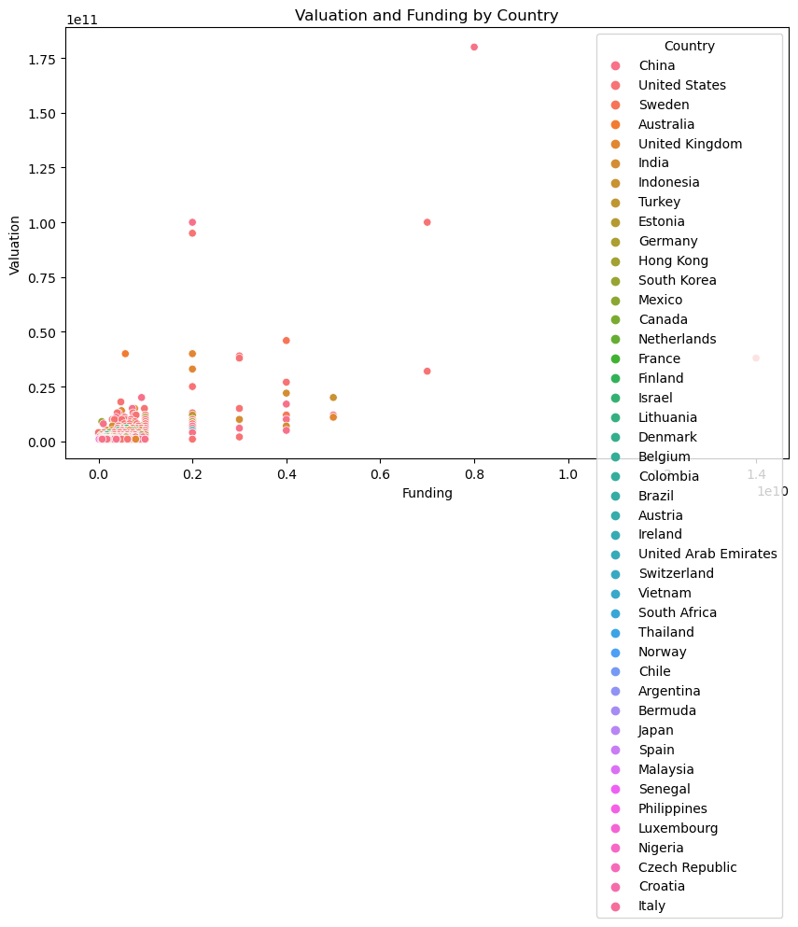
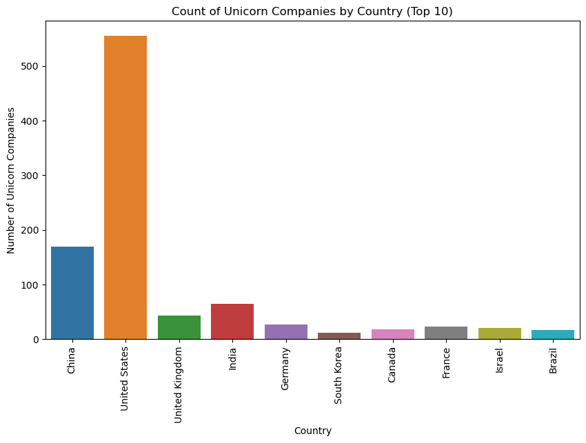

Slide 3
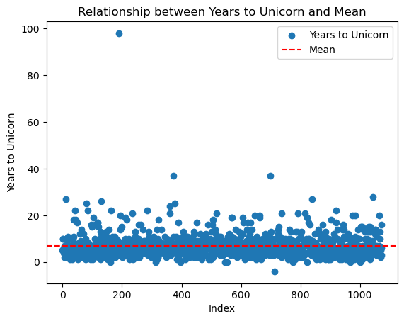
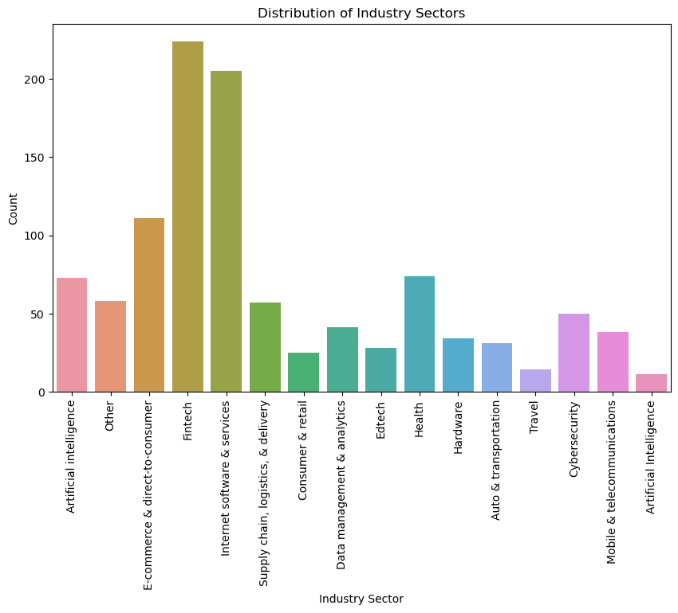

Slide 4
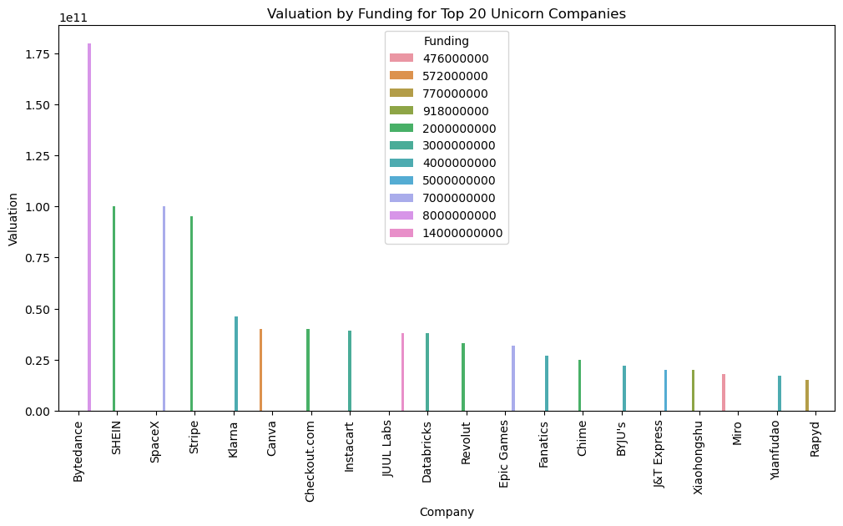

Slide 5
